Slide 1

THE FAEIS PROGRAM
&
NAUFRP INSTITUIONS
A collaborative project
PI: Pete Ziegler
Developer: Andrew Meeks
Dr. Peter Ziegler, PI
Andrew Meeks, Developer

Slide 2
Objectives
Introduction to FAEIS
How you can interface with the FAEIS system
Current Status of NAUFRP Data

Slide 3

What is FAEIS?
The Food and Agricultural Education Information Systems (FAEIS) is a national web-based database of student and faculty data.
Funded by USDA since 1983.
The program has been housed at Virginia Tech since 2002.
http://www.faeis.ahnrit.vt.edu/

Slide 4
  The FAEIS mission
  To gather, compile, and distribute a broad range of higher education information related to natural resources, agriculture, and Family Consumer Sciences
Notes:
Goals and Objectives of the FAEIS Help Desk
Provides human interface component to FAEIS.
Collaborate with reporting institution’s data entry users to collect data
Verify data collection with Deans of reporting institutions
Assist users with FAEIS
Generate reports for users

Slide 5
What is FAEIS?
Disaggregated data includes:
  Undergraduate and graduate student enrollment by ethnicity and gender.
  Degrees awarded at all levels by ethnicity and gender.
  Placement at all degree levels.
  Faculty head counts and salaries by race/ethnicity, gender, rank and discipline.
  Data comes primarily from 1862, 1890, 1994 and Non Land-Grant Institutions.
    Collect data from approximately 275 universities and colleges nationwide.

Slide 6
FAEIS Surveys
The Detailed Student Survey
The Faculty Survey
The Transfer Student Survey

Slide 7
The Primary Student Surveys
Three components:
Student Enrollment Survey reflects the Fall census for the current year. The survey collects Fall enrollment by degree level, discipline (CIP), gender, and ethnicity.
The Degrees Awarded Survey collects degrees each academic year by degree level, discipline (CIP), gender, and ethnicity.
The Placement of Graduates Survey collects data each academic year on the jobs that students receive after graduation, including the degree they received, the number of new graduates placed broken down by CIP program, and the place of work.

Slide 8
The Faculty Survey and
Transfer Student Survey
Faculty Survey collects data each Fall semester on faculty academic rank and tenure status, appointment type and percentage breakdown, the faculties' primary discipline (CIP), monthly salary, demographic information, and administrative position information.
Transfer Student survey is a pilot survey inquiring about transfer students who transferred into four-year programs from two-year programs.

Slide 9
How can FAEIS contribute to the conversation?
  To provide empirical information for use in planning and coordinating efforts, directed towards supporting higher education in natural resources, agriculture, and Family Consumer Sciences
  Specifically, as a part of an ongoing effort to investigate national enrollment trends pertinent to the Natural Resources.

Slide 10
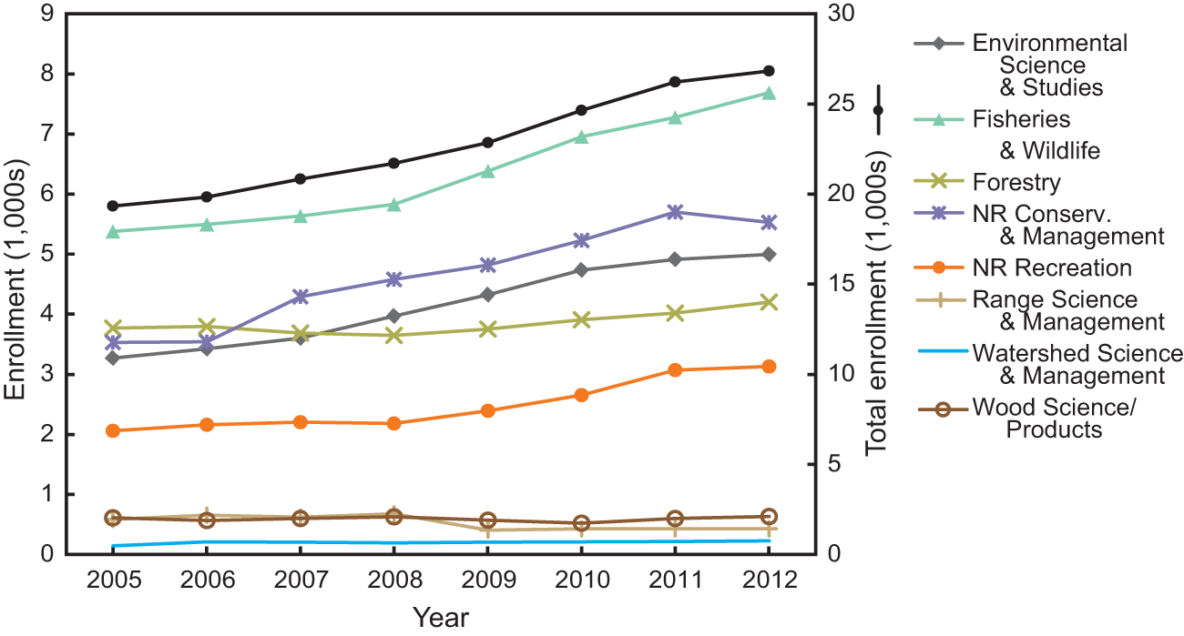
Trends
Sharik, Terry L., et al. "Undergraduate enrollment in natural resource programs in the United States: Trends, drivers, and implications for the future of natural resource professions." Journal of Forestry 113.6 (2015): 538-551.

Slide 11

How can FAEIS benefit you as a NAUFRP College?
Representation with your peers in external reports
  Forest Industry experts (pipeline)
  Government Program writers (diversity)
Comparability between your college and other members
  Programs offered
  Enrollment numbers
  Faculty composition
  Diversity ratios
  Benchmarking
Exploration of trends in emerging programs
Notes:
Go through case by case scenario of data requests? Emails:
FAEIS -> Done -> McWey, Lenore - 8/8/16 - asked for data we do not collect… yet
FAEIS -> Done -> Ervine, Erik - 7/12/16 - needed enrollment and degree data by major by college from SCHEV-approved peer institutions. Cannot obtain this from IPEDS. All peers need to have responded in years questioned to be comparable.
FAEIS -> Done -> Wagner, Leanne - 6/9/16 - Archer Daniels Midland needed metrics for Diverse students entering into, and completing their degrees in agriculture.
FAEIS -> Done -> Pina, Manuel - 4/17/16 - U.S. Congress Panel organized by the Congressional Hispanic Caucus Institute,
1. The universities that offer undergraduate and/or graduate programs in environmental science and geoscience in the U.S. Southwest (Arizona, New Mexico, Southern Colorado, Southern Utah, Southernmost Nevada, Southeast California, and Far West Texas)
2. The number of undergraduate and graduate students enrolled in these programs
3. The number of undergraduate and graduate students from underrepresented U.S. populations that are U.S. citizens, particularly Hispanics/Latinos
Inbox -> Waits, Lisette - 8/10/16 - UIDAHO, needed to evaluate the proportion of women and minorities in wildlife programs at different hierarchical levels including leadership (Department Head or Program lead), different faculty ranks, graduate and undergraduate students for two time periods (2005 and 2015). Also wanted to gather information on scholarships or support programs for underrepresented students. Ran survey on their own. Why? --- LOW FACULTY PARTICIPATION IN FAEIS--- effectively increase overall response effort by all involved.

Slide 12
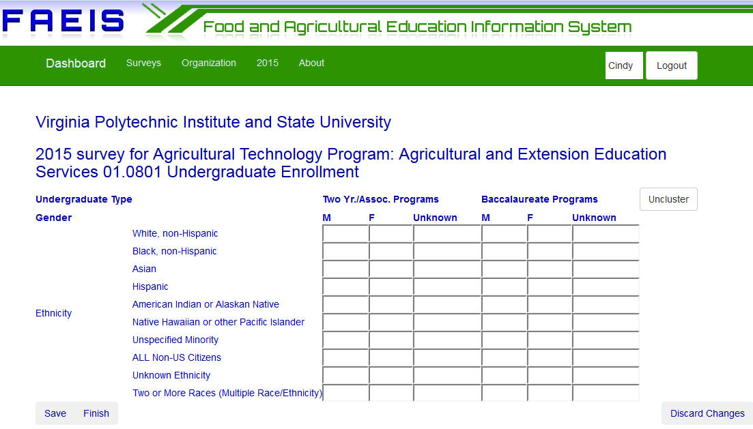
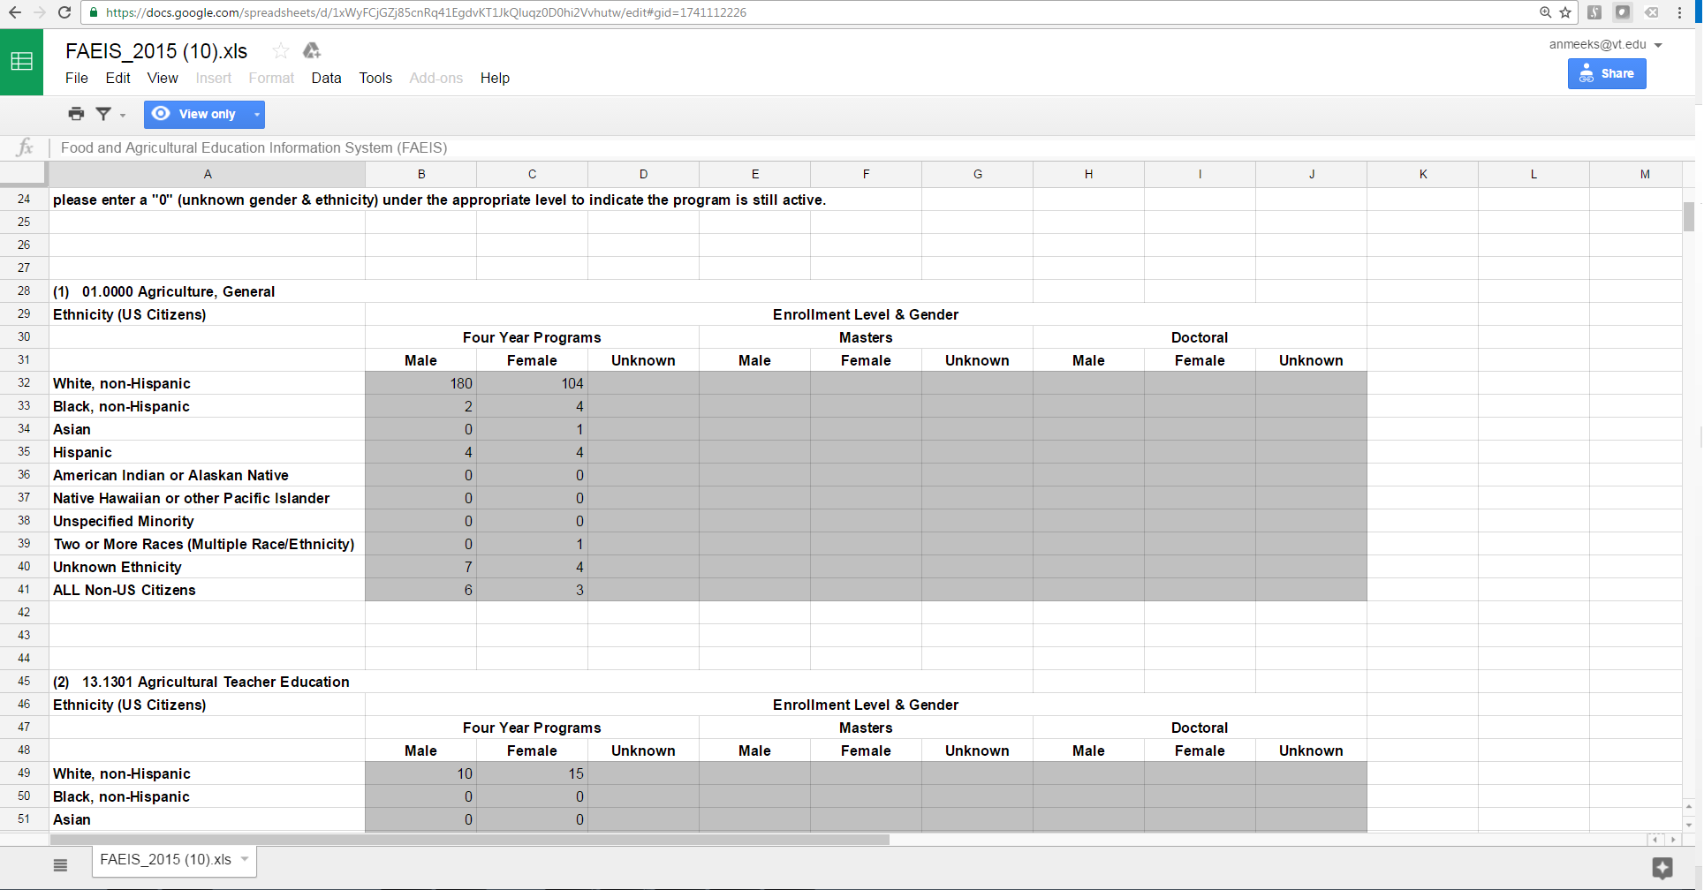
How do we collect your data?
Online survey instrument
Data extract *with oversight*
Help Desk
  Emails
  Phone calls
  Google docs
Notes:
A few institutions have public facing student metric portals. Most of these do not provide the granularity needed to complete our format. Of the ones that do, we prefer to not blindly import and validate what we have managed to pull. Is the data complete? Is the data accurate? Did we use the tool correctly? Authoritative institutional confirmation of the loaded data is important.
Talk to us about created a data extract process to populate your student information.
1. Identify programs and assign cips - (manual)
2. Run extract process
3. Review, correct, and confirm (Finish) surveys with loaded data.
Assisted data entry is possible for student data and, this year, will be required for faculty data. A self-serve faculty data interface will be added for 2017 surveys.

Slide 13

Meet the Help Desk!
3 Virginia Tech undergraduate students - here for you!
Assisted data entry
Account management
Institution configuration
Instructional Program management and Classification
Late reminders and survey quality assurance follow up
Notes:
These people are here to help you!
Bridge the gap between your data and ours. Work with them to negotiate a manner in which you can get us your data accurately with the least effort.
Each student specializes in a different range of institution types in order to be familiar with common characteristics and needs. Cathlean - 1890, 1994. Abbi - 1862. Taylor - NARRU, NLG, PVT.
Students research Point of Contact replacements at each institution as well as data entry replacements. Configures accounts in survey tool accordingly. Notifications and reminders are sent out based on these account details. Make sure we have yours updated! People retire, people change jobs, institutional memory can be wiped in the span of 1 year. We want to provide a bridge of continuity between years of reporting effort. - Help Desk Notes
Students pursue a complete set of instructional programs are reported for your college.

Slide 14
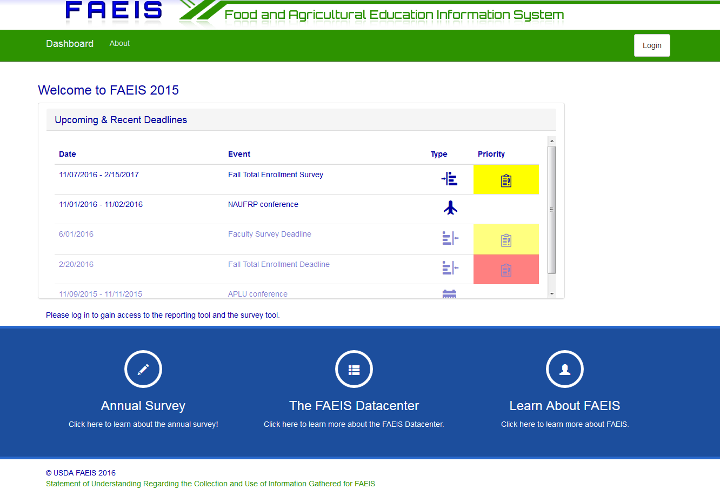
New FAEIS instrument
Available to beta testers now!
Improved reporting structure
Intra Institutional Transparency
Self Service
Audit Trail
Flexible Interface
Year-oriented, effective dated
Open for suggestions!
Notes:
IIT: you can see what your staff is working on and they can see their peers progress. Clear progress meters per college and institution.
IRP.: You input your programs AS YOU KNOW THEM, then assign CIP codes. Future surveys can be infinitely expanded through tag-based headcounts.
Self Service: Everything in the system can be done by existing institutional users without the need to call us. But don’t let that stop you!
Audit Trail: Because users are allow to self-service, a log of every data and structural change is maintained.
Flexible Interface: survey re-arrangement, responsive, dashboard based on roles, several different ways to access programs and organization structures.
YO,EF: Each program change, unit change, or staff change is entered as effective for the year in which you are working. That record will remain the one used until a record in a more recent year overrides it. This allows us to observe your contact, structure, and program profile in each historical year as it actually was during that time. A users active status is always current for determining permissions and authentication. A dean who used to be a reporter would be able to go back to those earlier years and perform structural changes. Historical data can be rectified at any time. Program changes require a reason, for tracking purposes.

Slide 15
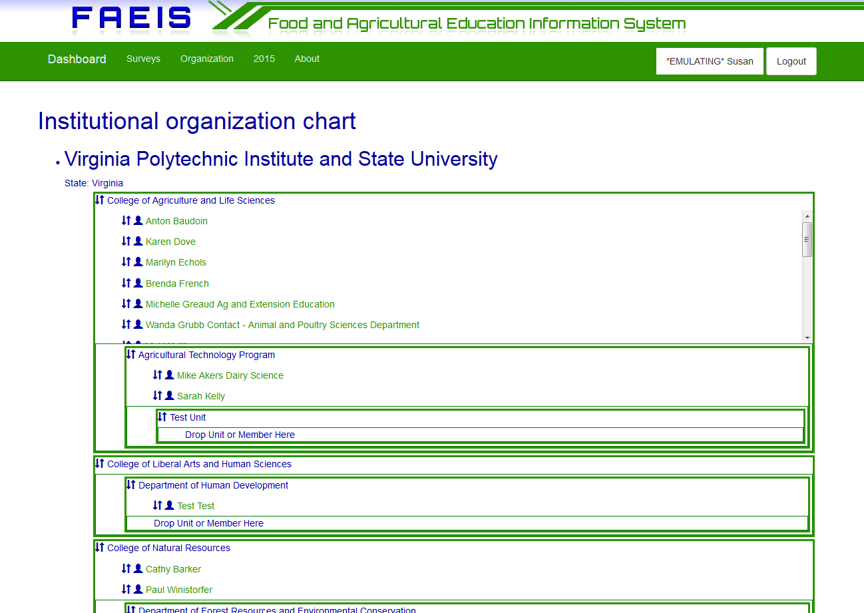
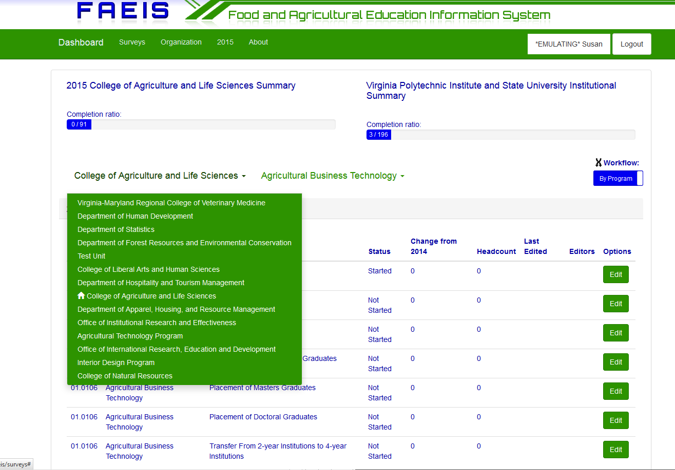
Transparent and holistic management
Notes:
Institutional structure and membership has always been self reported by agents at the given institution. All of this functionality is now self-serve within your own institution. Users who apply a role of manager receive different tools on different screens to perform relevant tasks. Agents at the institution or FAEIS helpdesk can create accounts within the institution. Users who have created their own account must ask the helpdesk to be added to that institution.

Slide 16
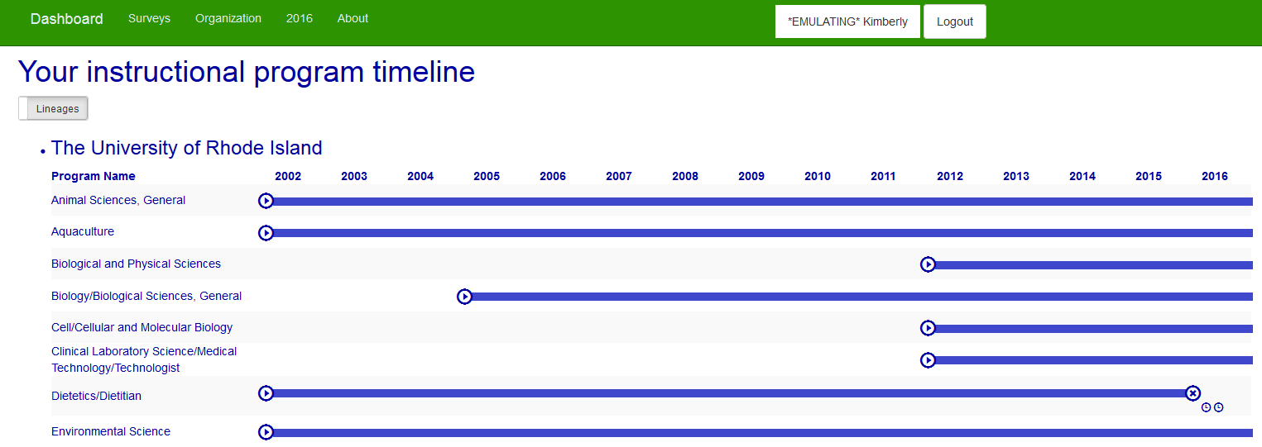
Emerging program sensitivity
Programs can begin, end, split, merge, move, and change over time
Institutional structure provides a year-by-year framework for organizing survey and programs
Notes:
Program conclusions require a reason. Investigators can tabulate free-form reasons later as they wish.
Classification of program can change year to year. Observable classification drift.
Program paternity tracks evolution. Visualized with lineages.
Programs can move from one college or department to another

Slide 17
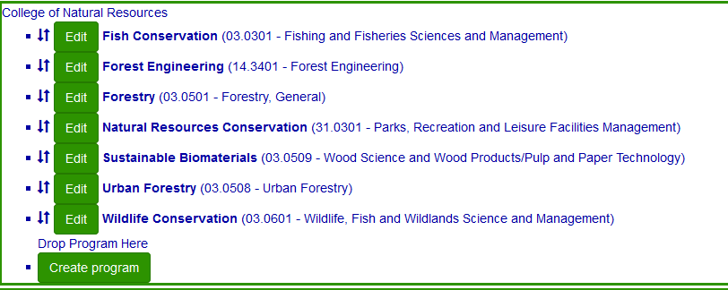
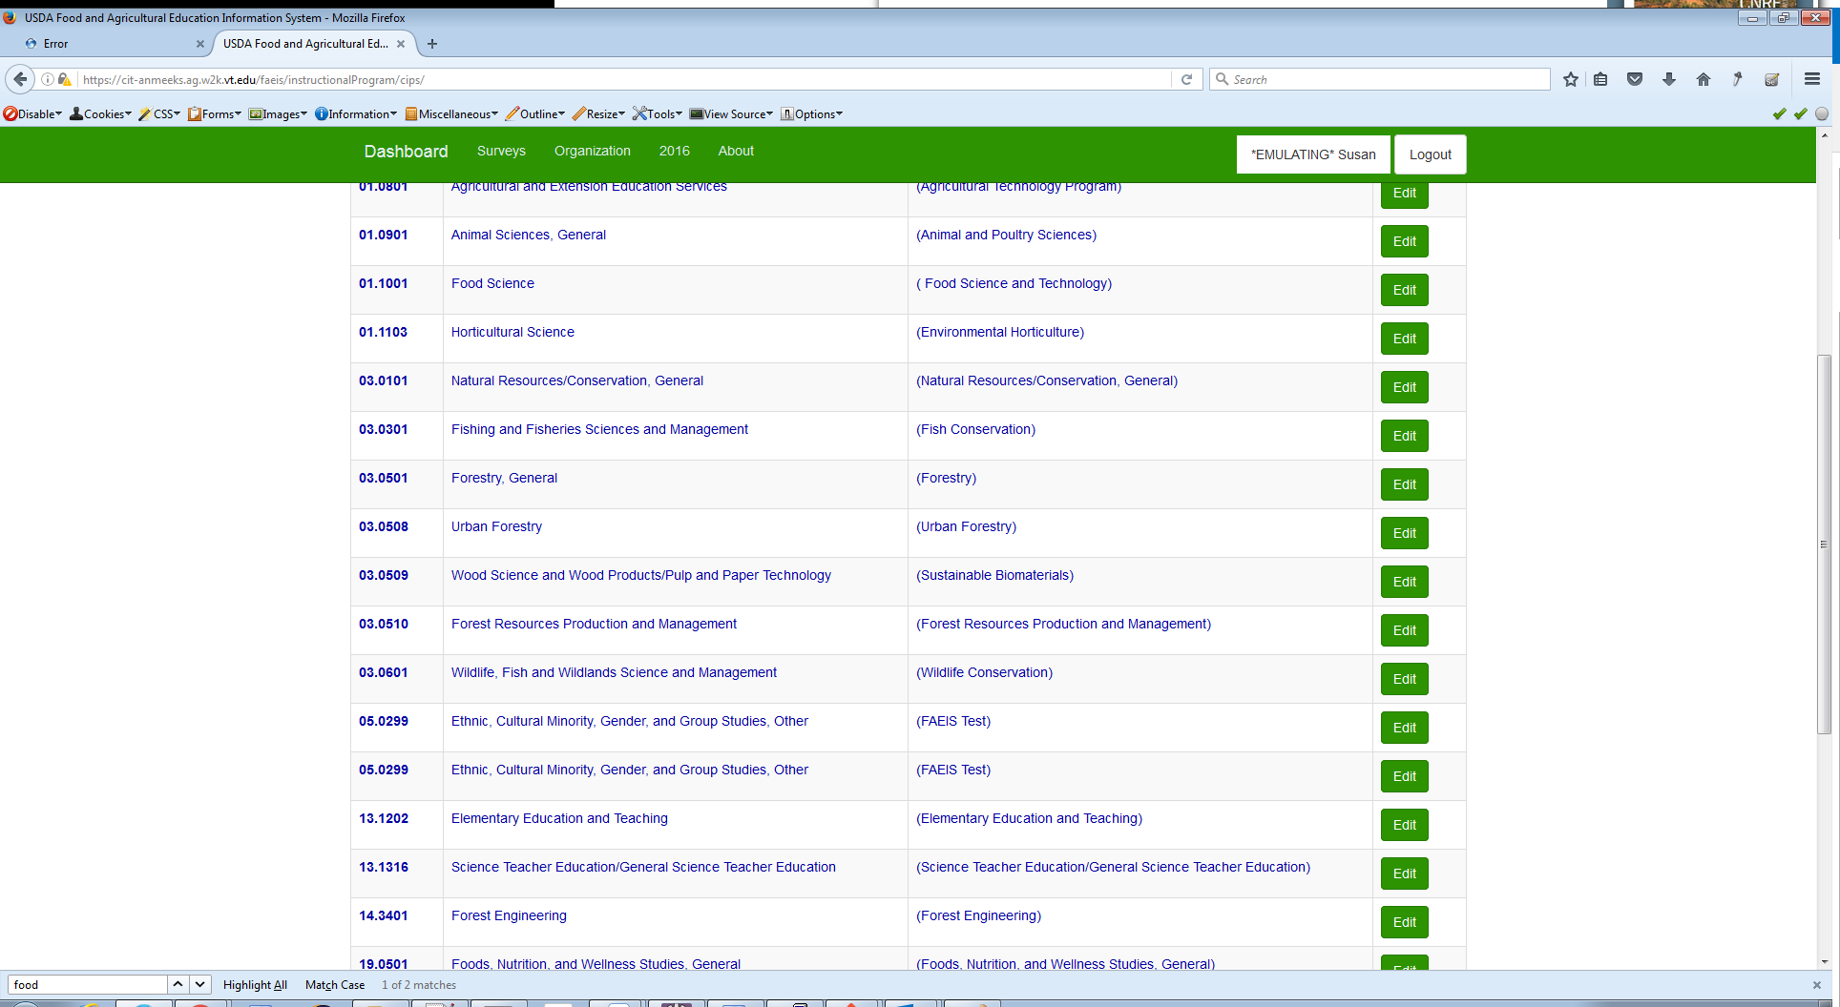
Independent Labels
Programs are now
independent of classification
Share with others
your own program name

Slide 18

Workflow
By Form OR By Program
Start in your home college
Grid clustering
Autocapture of work
Sticky surveys
Progress bars
Quality indicators
Notes:
Remind/Clarify/Demo about pasting from excel
Non-repudiation - shows user and time, history kept for 5 years.
Suck in same survey once changed until saved or discarded.
Explain stock market arrows -> sign that we will be contacting you about quality issue later on.

Slide 19

Newsletters
Bi-Monthly
Requests for topics appreciated! Let us serve you!
Trends, totals, state of the data
Feature your college, submit photos!

Slide 20

Quality Assurance
Vetting based on historical data and IPEDS pipeline mouth
Triage levels - Institution/College/Program
Flag based - cleared with review
Missing/Big Change
Pursued during contact

Slide 21
Status of NAUFRP Enrollment Reporting 2013-2015
68 members in FAEIS
42 institutions with contiguous data
(18 flagged by preliminary quality assurance check)
12 institutions have not contributed
14 have given 1-2 years of data

Slide 22
NAUFRP Institutions with Contiguous Data
Auburn University
California Polytechnic State University
Clemson University
Colorado State University
Cornell University
Iowa State University
Kansas State University
Kentucky State University
Louisiana State University
Michigan Technological University
New Mexico State University
North Carolina State University at Raleigh
Northern Arizona University
Oklahoma State University
Oregon State University
Purdue University
Rutgers University- New Brunswick
Southern Illinois University-Carbondale
Texas A&M University
The Ohio State University
The Pennsylvania State University

Slide 23
NAUFRP Institutions with Contiguous Data
University of Maine
University of Missouri
University of Nebraska- Lincoln
University of Nevada- Reno
University of Vermont
University of Washington- Seattle
University of Wisconsin- Stevens Point
Utah State University
Virginia Polytechnic Institute and State University
Washington State University
West Virginia University
The University of Rhode Island
University of Alaska- Fairbanks
University of Arizona
University of Arkansas at Monticello
University of California- Berkeley
University of Connecticut
University of Delaware
University of Idaho
University of Illinois at Urbana-Champaign
University of Kentucky

Slide 24
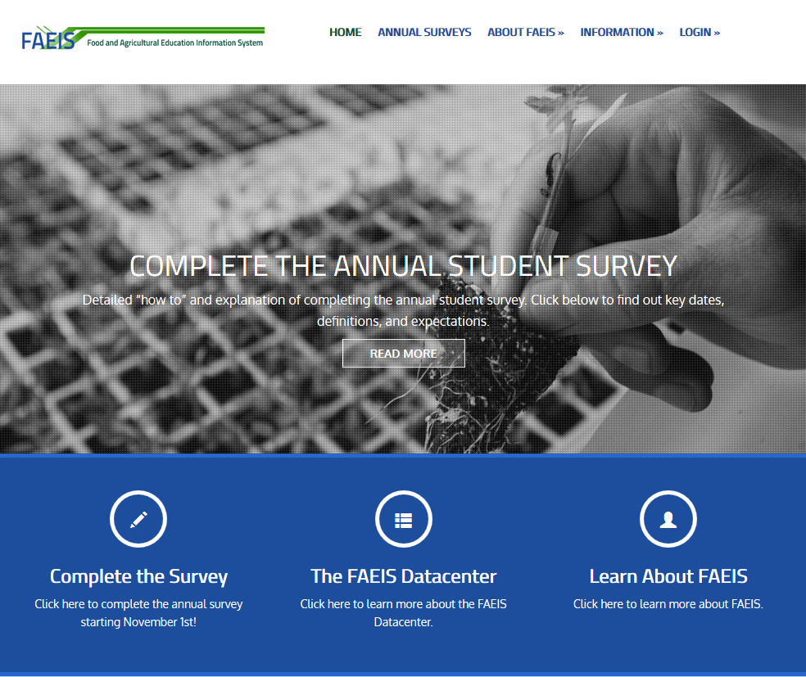
http://faeis.usda.gov/

Slide 25
FAEIS Going Forward
Faculty survey
Placement survey
Increase collaboration with institutions and academic organizations to provide a platform for deeper questions.

